Slide 1


Slide 2

About Me
My Name Is B Shiva Sai Prasad.
Graduation In Electronics Communication Engineering.
I’ve Passion For Become An Data Analyst.
LinkedIn : B Shiva Sai Prasad

Slide 3
Agenda
Business problem
Objectives
ER Daigram
Key Analysis Questions
Challenges
Recommendations
Conclusion

Slide 4
Business Problem
Inventory Stock Management Issues
Sales Trend Analysis (Daily/Monthly)
Identifying Top And Low Selling Products
Customer Purchase Behavior Analysis
Supplier Performance Evaluation
Profit Margin And Revenue Analysis

Slide 5
Objectives
Manage And Track Inventory Levels Efficiently
Analyze Sales Data To Identify Trends And Patterns
Generate Reports For Top-selling And Low-selling Products
Monitor Customer Purchase History And Buying Behavior
Calculate Revenue, Expenses, And Profit Margins For Better Decision-making

Slide 6
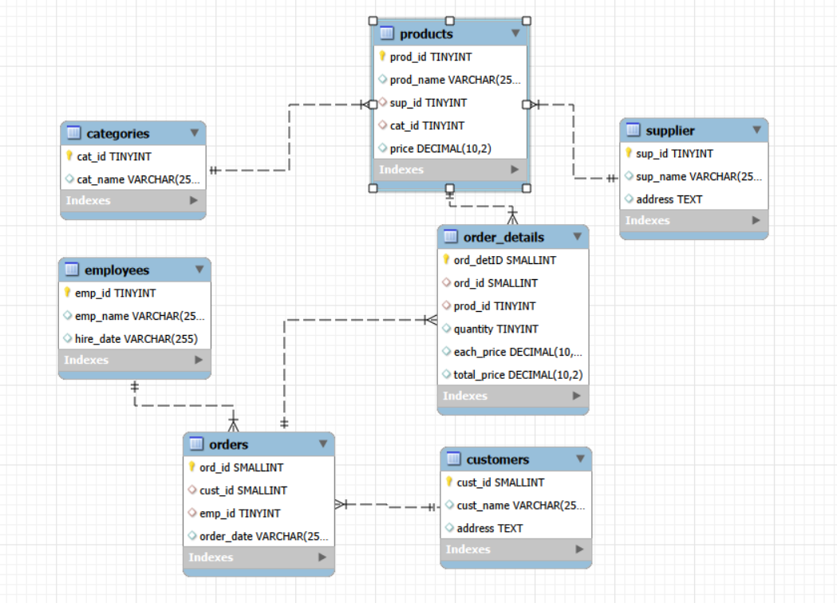
ER Daigram

Slide 7
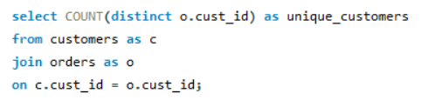

Key Analysis Questions
How Many Unique Customers Have Placed Orders?
query
Output

Slide 8
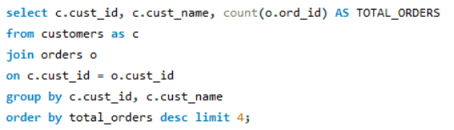
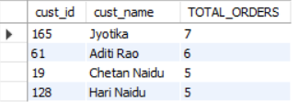
Which Customers Have Placed The Highest Number Of Orders?
query
Output

Slide 9
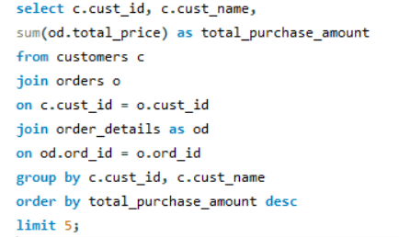
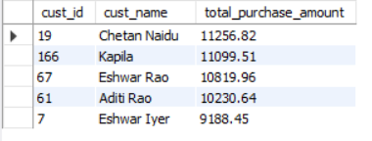
Who Are The Top 5 Customers By Total Purchase Amount?
query
Output

Slide 10


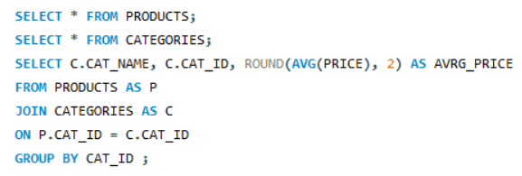
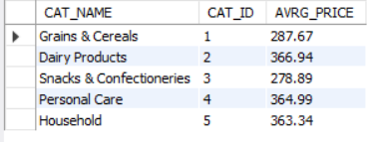
Product Performance
How Many Products Exist In Each Category?
query
Output
What Is The Average Price Of Products By Category?
query
Output

Slide 11
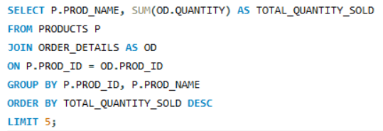
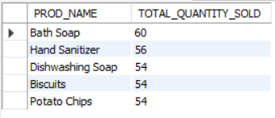
Which Products Have The Highest Total Sales Volume (By Quantity)?
query
Output

Slide 12


Sales and Order Trends
How Many Orders Have Been Placed In Total?
query
Output
What Is The Average Value Per Order?
query
Output

Slide 13
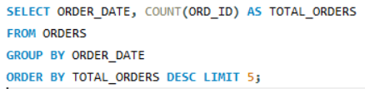
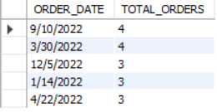
On Which Dates Were The Most Orders Placed?
query
Output

Slide 14

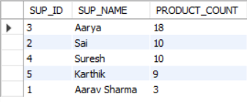
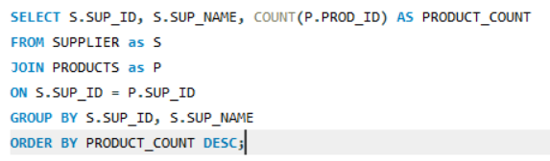
Supplier Contribution
How Many Suppliers Are There In The Database?
query
Output
Which Supplier Provides The Most Products?
query
Output

Slide 15
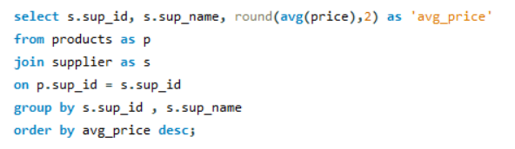
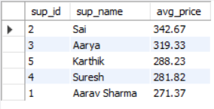
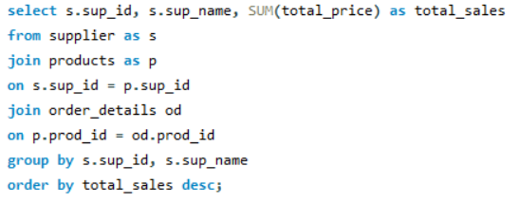
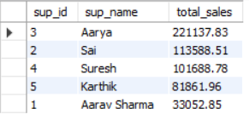
What Is The Average Price Of Products From Each Supplier?
query :
Output
Which Suppliers Contribute The Most To Total Product Sales (By Revenue)?
query :
Output

Slide 16


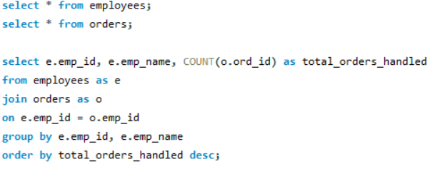
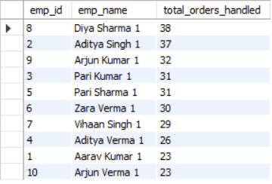
Employee Performance
How Many Employees Have Processed Orders?
query
Output
Which Employees Have Handled The Most Orders?
query
Output

Slide 17
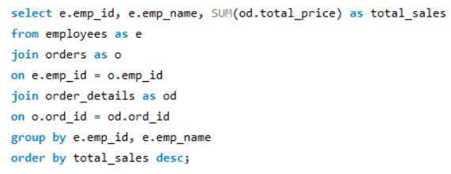
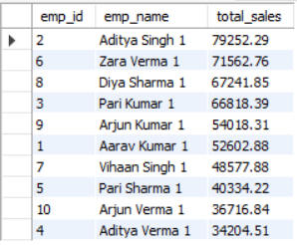
What Is The Total Sales Value Processed By Each Employee?
query
Output

Slide 18
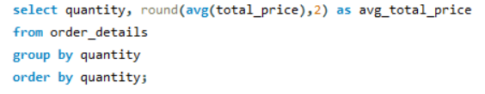
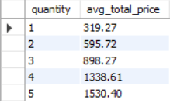
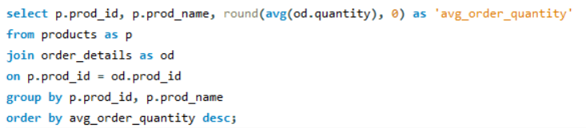
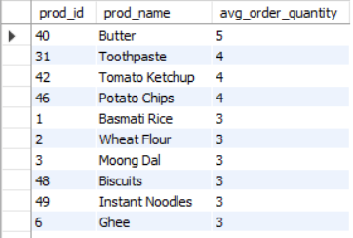
Order Details Deep Dive
What Is The Relationship Between Quantity Ordered And Total Price?
query
Output
What Is The Average Quantity Ordered Per Product?
query
Output

Slide 19
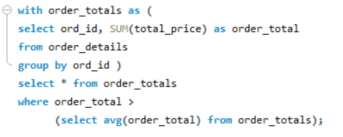
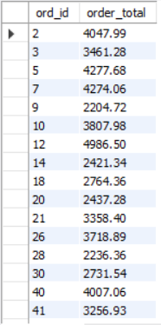
Find Orders Where Total Purchase Value Is Above The Overall Average Order Value.
query
Output

Slide 20
Challenges
Handling large volumes of sales and transaction data
Maintaining data accuracy and consistency across tables
Managing real-time inventory updates after each sale
Designing efficient joins between multiple related tables
Optimizing SQL queries for better performance
Handling missing, duplicate, or inconsistent data entries

Slide 21
Recommendations
Implement automated low-stock alerts for inventory management
Use sales trend reports for better demand forecasting
Focus on promoting high-margin and fast-moving products
Maintain accurate and normalized database structure
Optimize SQL queries using indexes for better performance
Regularly clean and validate data to ensure accuracy

Slide 22


